Slide 1



PROMETRA
Scaling Impact, Deepening Connection
2027
THE PROMETRA WAY OF REMEMBERING
2027 STRATEGIC GROWTH PLAN

Slide 2
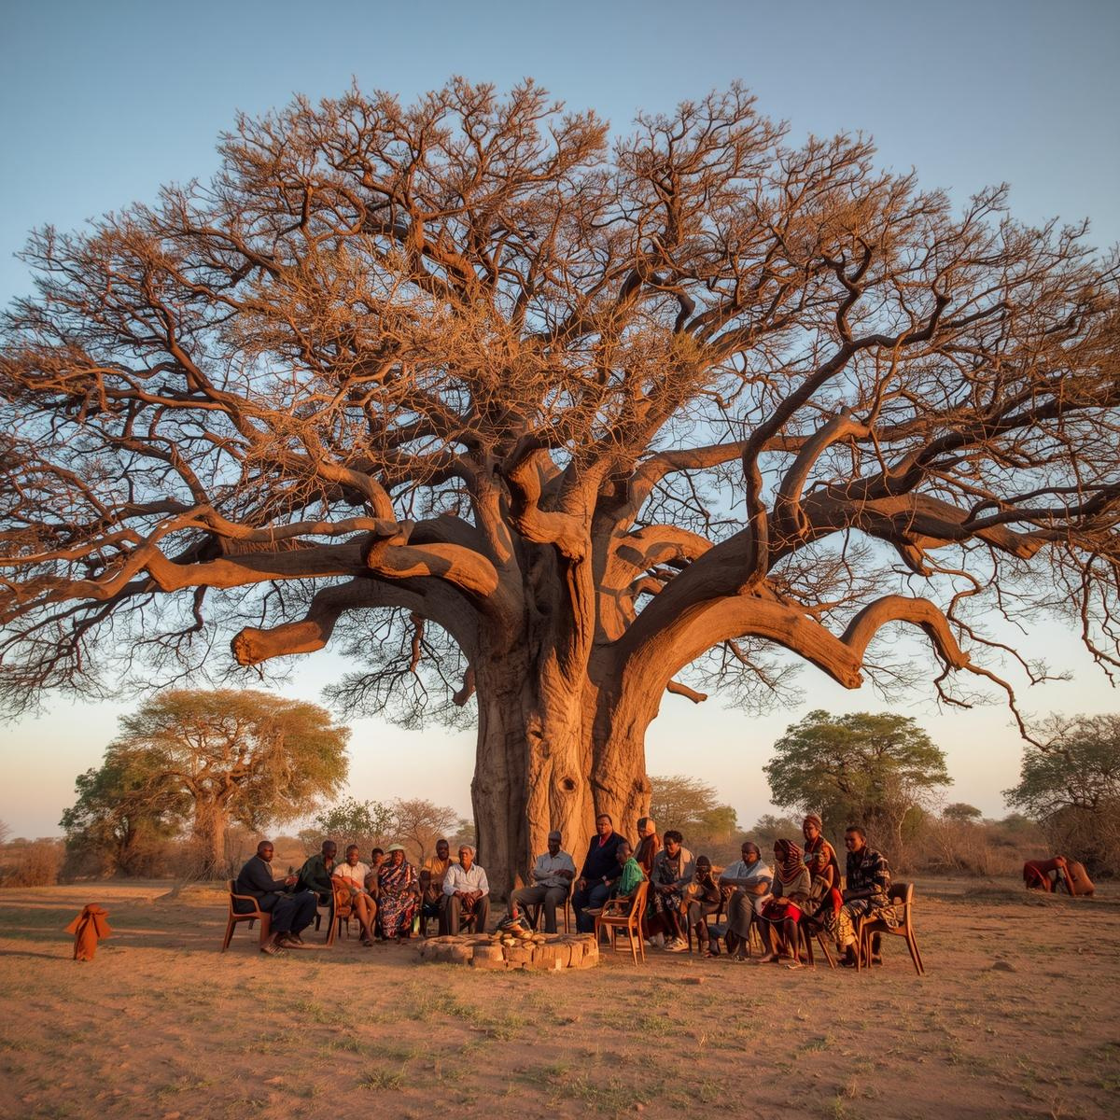

Strategic Vision
The Way of Remembering 2027 Strategic Plan charts an ambitious path to scale our transformative program to 50 participants annually while pursuing a $10M fundraising goal. Rooted deeply in West African traditions and experiential learning, this comprehensive strategy positions Prometra for sustainable growth and lasting cultural impact.
Four Strategic Pillars
Fundraising • University Partnerships • Recruitment Infrastructure • Brand Development
Executive
Summary

Slide 3
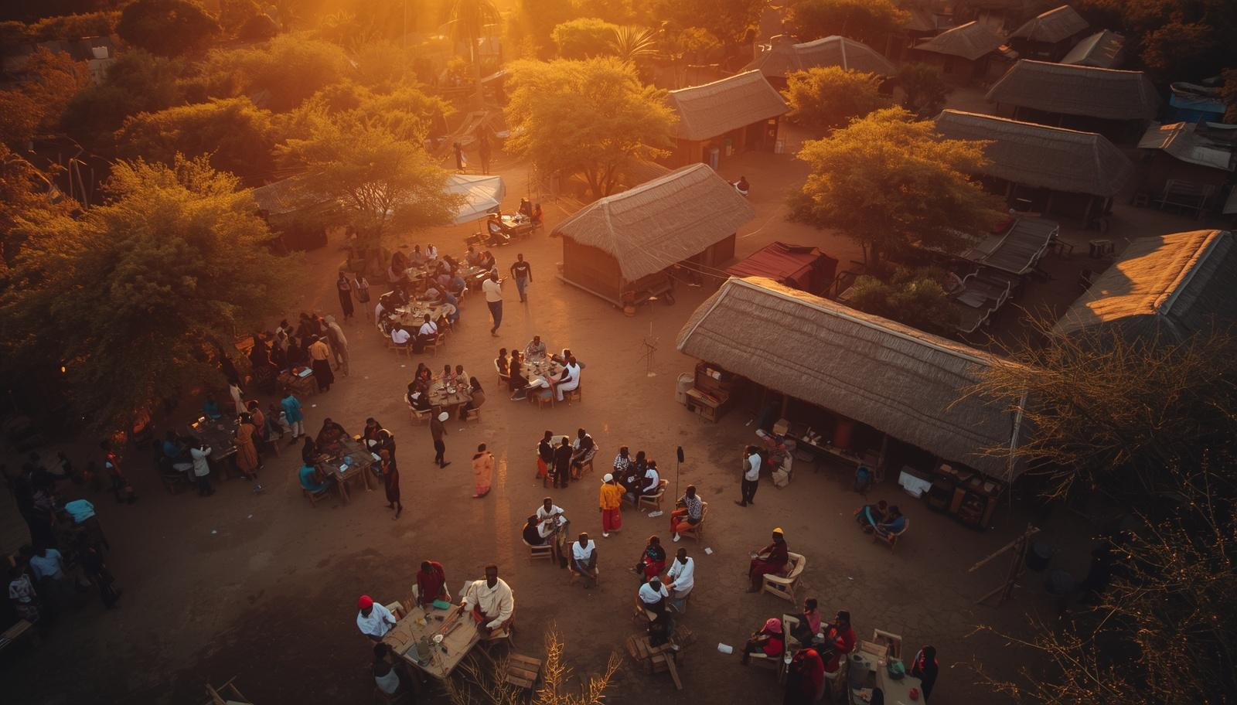





Financial resilience ensures mission alignment and lasting impact.
Fundraising
$10M
Strategy
Fundraising Goal
Institutional & Major Gifts
Grants
Community & Events
$6M target through cultivated relationships with foundations, corporations, and high-net-worth individuals aligned with our cultural mission.
$2M from cultural preservation, education, and global studies foundations supporting experiential learning programs.
$2M combined from merchandising, community giving, monthly donors, and special events building collective ownership.

Slide 4


Our comprehensive fundraising strategy is built on four key pillars, each designed to create sustainable financial support for the Way of Remembering program.
$10 Million Goal
01
02
03
Institutional & Major Gifts
Grants
Merchandising & Community Fundraising
$6 Million Target
Cultivating relationships with foundations, corporations, and high-net-worth individuals aligned with cultural preservation and experiential education.
$2 Million Target
Pursuing cultural heritage, educational, and global studies grants from government agencies and private foundations.
$1 Million Target
Culturally-inspired merchandise and grassroots community giving campaigns that deepen connection to the WOR mission.
Fundraising
Breakdown

Slide 5
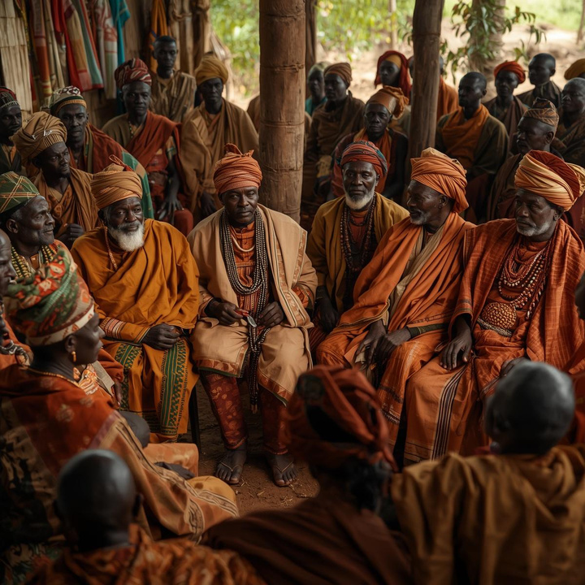
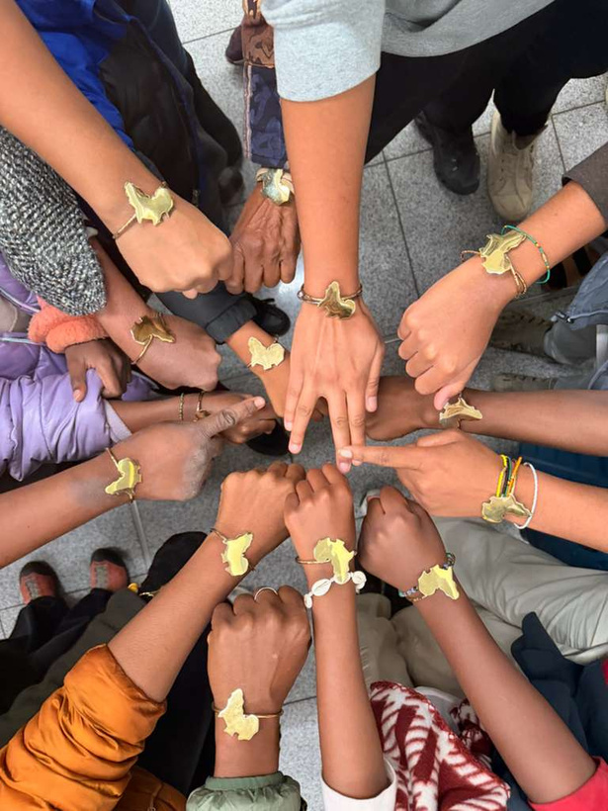
Stewardship Model
& Giving Tiers
Ancestral Circle
$1M+ commitment honoring legacy and transformational impact.
Governance Principles
Donor Partnership
Legacy Circle
$250K–$999K supporting sustained growth and cultural preservation.
Prometra retains full governance and programmatic autonomy over all initiatives and strategic decisions.
Donors support the mission without gaining decision-making authority, honoring traditional leadership structures.
Guardians of the Way
Community-based monthly giving program designed to build a sustainable base of recruiting support,

Slide 6


Guardians of
The Way
Our monthly giving initiative transforms supporters into active participants in the Way of Remembering journey. Through community-based recurring support, donors build long-term connections rooted in collective responsibility and shared purpose, honoring the West African tradition of communal care.
MONTHLY GIVING COMMUNITY
Impact
5.0

Slide 7





Pitch Deck
Develop compelling presentation
Donors
Identify 10–20 major prospects
Grants
Apply for cultural & educational grants
Fundraising
Campaign
Launch monthly giving program
Key Actions

Slide 8


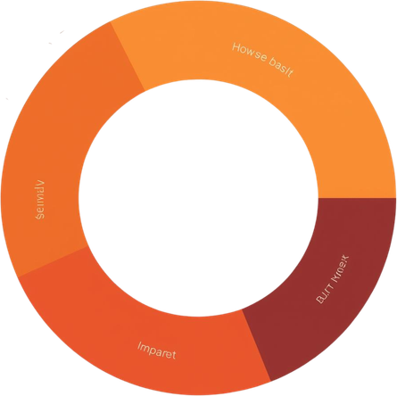
Impact of the
Transformative outcomes enabled by achieving our fundraising target, creating lasting change for the Way of Remembering program.
$10M Fundraising Goal
Scholarship Accessibility
University Partnerships
50%
8
Removing financial barriers to ensure diverse participation in cultural immersion.
Formal agreements enabling academic credit and financial aid access.
Recruitment Infrastructure
Program Excellence
6+
100%
National ambassador network and digital systems for scalable outreach.
Enhanced curriculum, storytelling, and content for movement-building.

Slide 9


Strategic Objectives
Enable academic credit and financial aid access for WOR participants through formal university partnerships. This strategic alignment opens pathways for students to receive institutional support while engaging in transformative cultural education rooted in West African traditions.
Partnership Approach
Prometra serves as program provider while universities process tuition and credit. Target institutions: Morehouse School of Medicine, Emory, Morehouse College, Spelman, Clark Atlanta.
University
Partnership Strategy

Slide 10
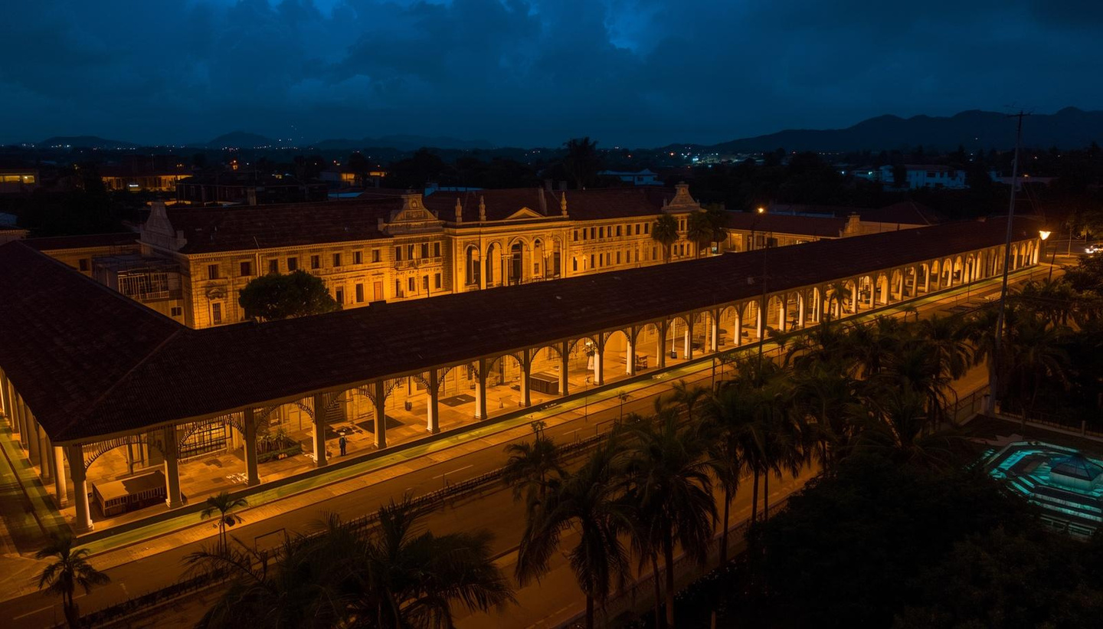

Building strong academic partnerships requires strategic outreach and formal agreements to enable credit transfer and financial aid access for WOR participants.
Immediate Actions
01
Secure Faculty Sponsors
02
Develop Academic Framing
03
Formalize Partnership Agreements
Identify and engage faculty champions at target universities who can advocate for the program and facilitate academic integration within their departments.
Position WOR within recognized academic disciplines including public health, global studies, African diaspora history, and cultural anthropology for credit eligibility.
Draft and execute formal MOUs with partner institutions outlining credit transfer protocols, tuition processing, and program delivery responsibilities.
University
Partnerships Next Steps

Slide 11


Way of Remembering Campus Fellows
Student leaders serve as ambassadors across 6–8 university campuses, building bridges between their communities and the Way of Remembering program.
Key Roles:
• Host campus events and info sessions
• Recruit prospective participants
• Promote program and merchandise
• Share personal WOR experiences
Ambassador Incentives
• $500 stipend for program promotion
• $1,000 travel credit toward WOR journey
Campus Ambassador
Program Overview

Slide 12

Measurable impact through dedicated campus leadership.
Ambassador KPIs
50
& Targets
Leads Per Ambassador
Leads Generated
Applications
Enrollments
Each campus ambassador targets 50 qualified leads through events, social media outreach, and peer-to-peer engagement on their campus.
Converting interest to action, ambassadors guide 15 prospective participants through the application process per recruitment cycle.
The ultimate goal: 5 confirmed enrollments per ambassador, building toward our 50-participant program capacity.

Slide 13


Recruitment
A strategic five-stage process transforming awareness into committed WOR participants through targeted engagement and meaningful connection.
Funnel Overview
Awareness
Interest
500
75
Campus events, social media campaigns, and community outreach.
Email capture, info sessions, and lead magnet engagement.
Application
Interview & Enrollment
150
50
Online application submission with personal statements and references.
Personal interviews leading to final participant selection and enrollment.

Slide 14

Leads
Track all prospect contacts and sources
Interactions
Log touchpoints and engagement history
Progress
Monitor funnel stage advancement
CRM Tracker
Scaling
Enable growth and accountability
Structure

Slide 15


Email Marketing &
Landing Page Strategy
Lead Magnet
"5 Lessons from the Way of Remembering Journey" - downloadable guide.
Platform Options
Landing Page Features
Email Sequence
Mailchimp or ConvertKit for email automation, segmentation, and campaign management to nurture leads through the recruitment funnel.
Program overview, participant testimonials, email capture form, and direct application link to convert visitors into applicants.
Welcome → Story → Testimonial → Program Overview → Call to Action.

Slide 16
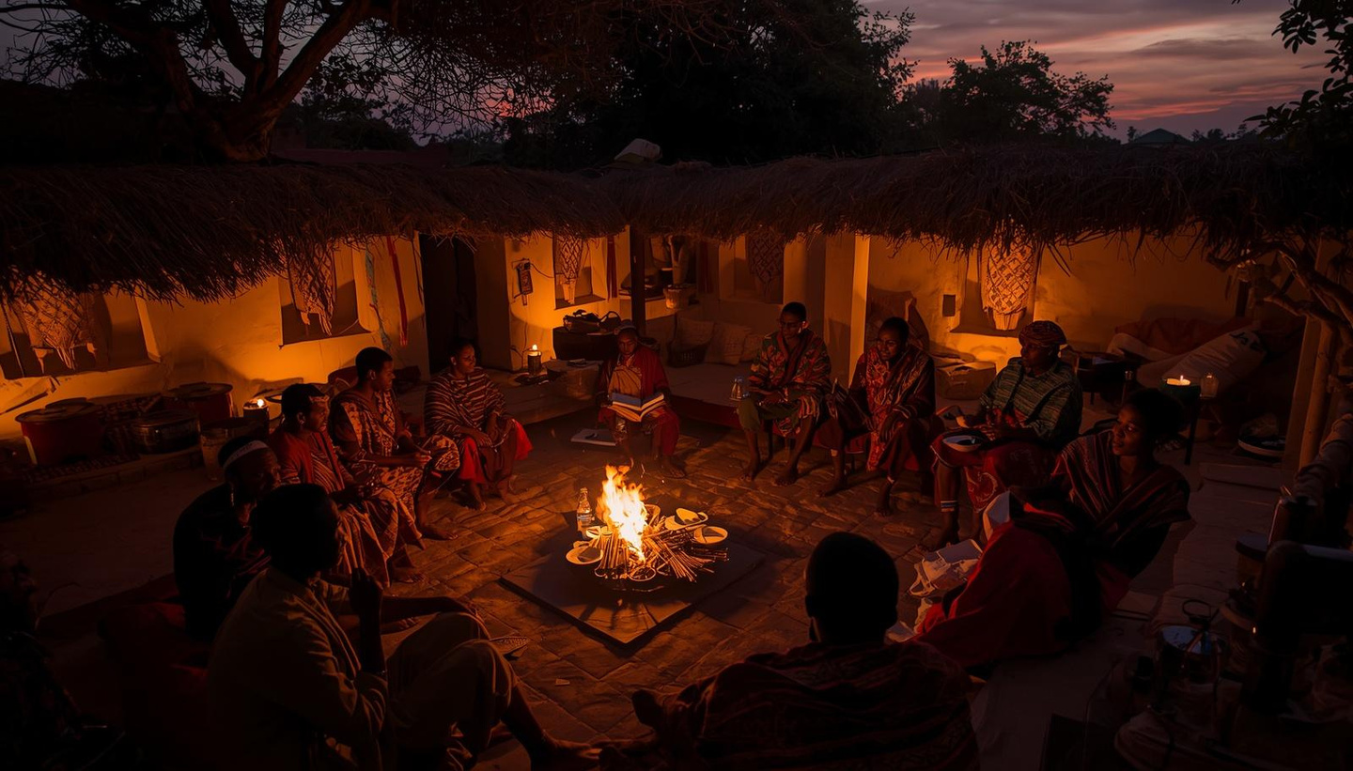

Our Narrative Approach
Authentic storytelling connects hearts and minds, transforming supporters into advocates through shared experiences of cultural awakening and personal growth.
01
02
03
Content Themes
Storytelling Tactics
Distribution Channels
Personal transformation journeys, cultural learning discoveries, and community connection stories that resonate with prospective participants and donors alike.
Video testimonials from alumni, social media clips capturing key moments, written reflections, and ambassador-generated content for authentic voices.
Weekly storytelling posts across platforms, QR codes on merchandise and ads linking to stories, and integrated content in email campaigns.
Storytelling
Strategy

Slide 17

Pitch Deck
Finalize fundraising pitch deck
Ambassadors
Launch campus ambassador program
Digital
Build landing page & email funnel
Next Steps
Partnerships
Secure 2–3 university meetings
(30–60 Days)

Slide 18

Thank You for Walking This Journey With Us
“When we remember, we reconnect—to history, to one another, and to our shared humanity. The Way of Remembering is more than a program—it is a living pathway to understanding, connection, and global experience.”
Join us in building this vision.
To explore partnership opportunities, contact: Nehanda Jones, Program Coordinator at nehandajones@gmail.com
www.prometra.org

